Slide 1



and : Getting HELP

Slide 2
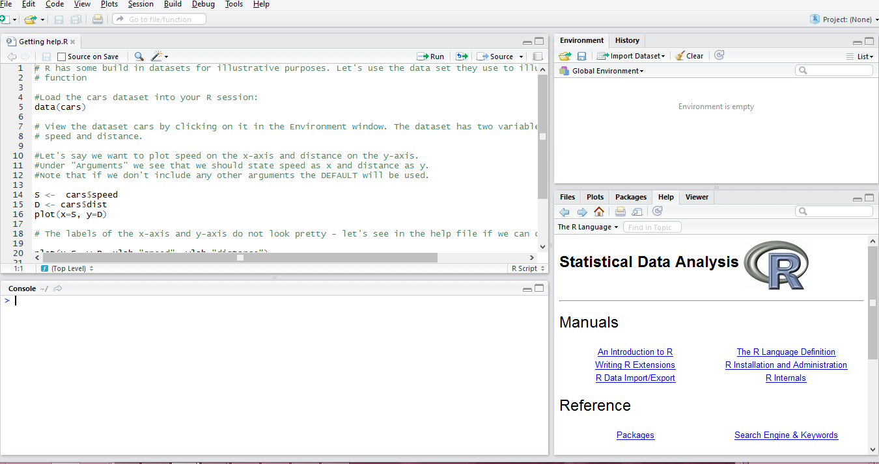
The R help files
Go to the Help window in R Studio (click on home button)

Slide 3
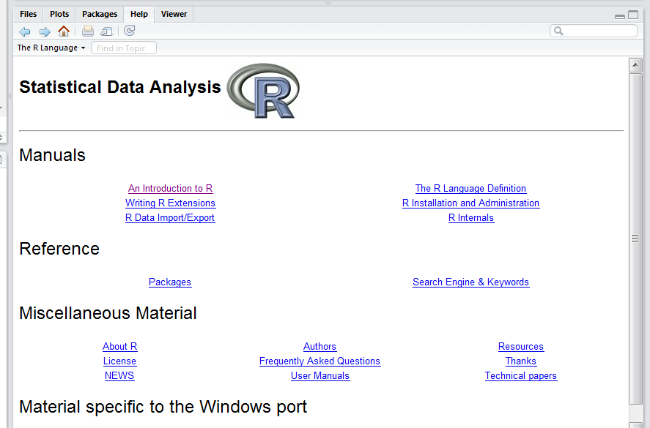

The R help files
You are presented with this problem:
Draw a random sample of 20 from a list of 100 participants
“random sample” is a key phrase to search for:

Slide 4
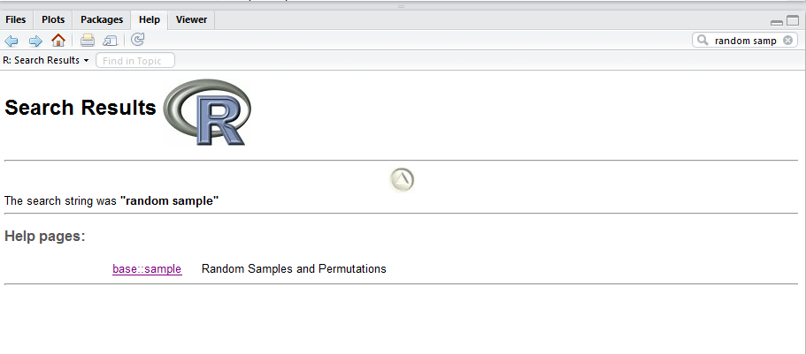
The R help files
This will return a list of all help files that contain the phrase “random sample”:

Slide 5
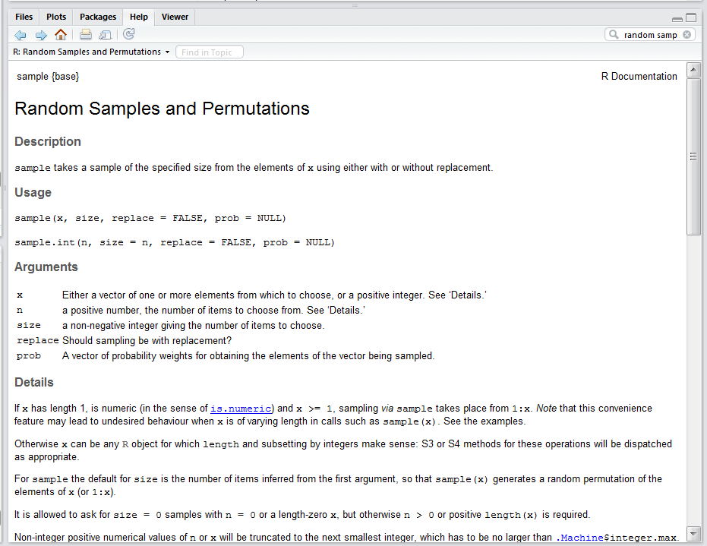
The R help files
Click on the page that looks the most appropriate:

Slide 6
The sample() function
Say you have a list of 100 participants and their unique identifiers are simply 1 to 100.
participants <- 1:100
Randomly select 20 of the 100:
sample(participants, 20)
[1] 76 57 56 50 53 28 34 20 49 22 96 70 100 73 79 92 62 38 94 54
sample(participants, 20)
[1] 23 48 75 27 32 70 60 68 100 88 29 2 38 74 93 61 81 26 15 11
sample(participants, 20)
[1] 23 14 100 10 51 37 75 30 81 15 57 17 61 45 83 25 65 41 6 36

Slide 7
The sample() function
What else can the sample() function do?
sample(participants, 20, replace = TRUE)
[1] 65 52 40 30 74 77 83 88 89 78 97 69 2 84 60 14 78 77 11 91
sample(participants, 20, replace = TRUE)
[1] 57 90 57 97 75 17 99 16 22 74 95 48 71 91 14 60 29 56 63 30
weights <- c(rep(2,50),rep(1,50))
sample(participants, 20, prob=weights)
[1] 19 73 36 75 50 44 43 59 48 39 91 11 35 41 7 92 6 12 87 52
sample(participants, 20, prob=weights)
[1] 47 87 14 33 37 59 7 93 35 40 60 44 29 77 30 18 78 48 26 41

Slide 8
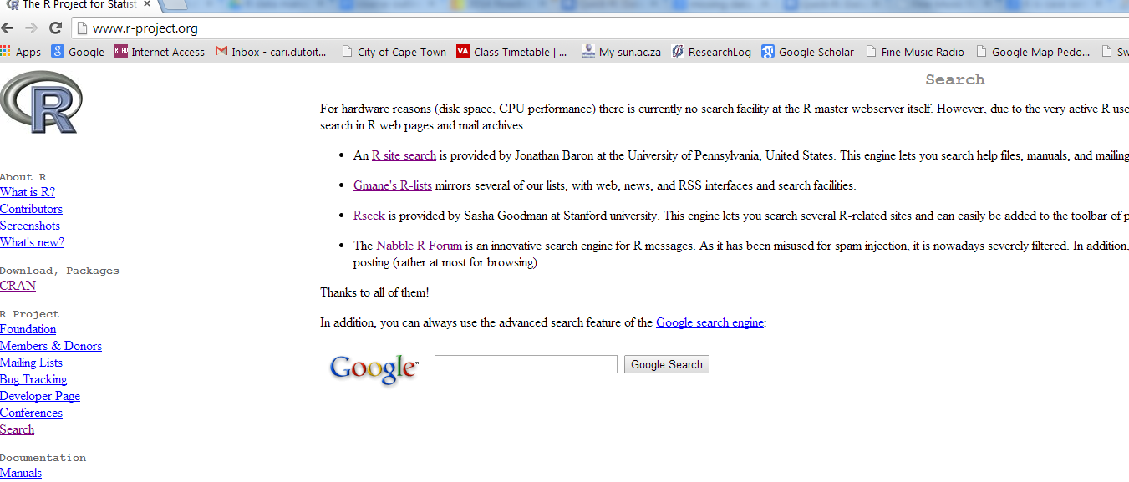
R-project.org
If you cannot find what you are looking for in the help files, go to the R website’s “Search” tab at: http://www.r-project.org/

Slide 9
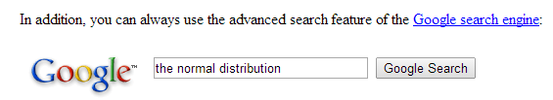
R-project.org
From here you can search in any of the four links provided, or you can perform a Google search.

Slide 10
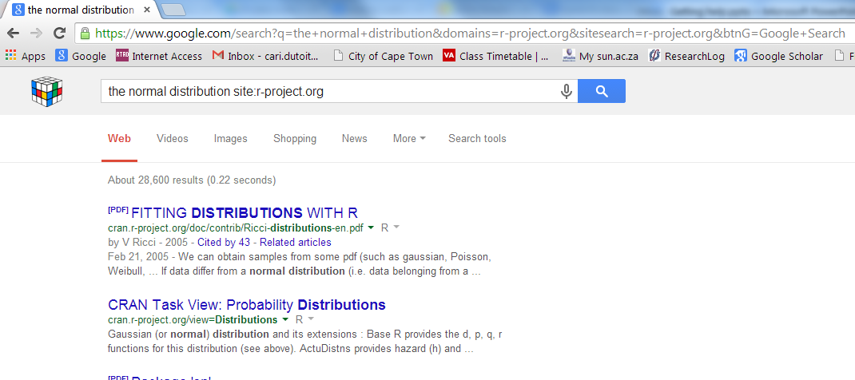
R-project.org
This will do a Google like search within the R-project website

Slide 11
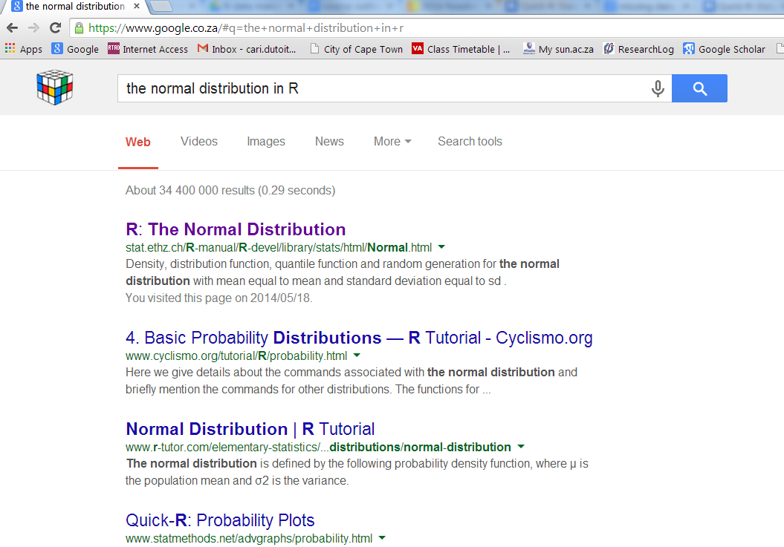
Google Search
You can also do a Google search, but be sure to add “in R” at the end of what ever you want to search.

Slide 12
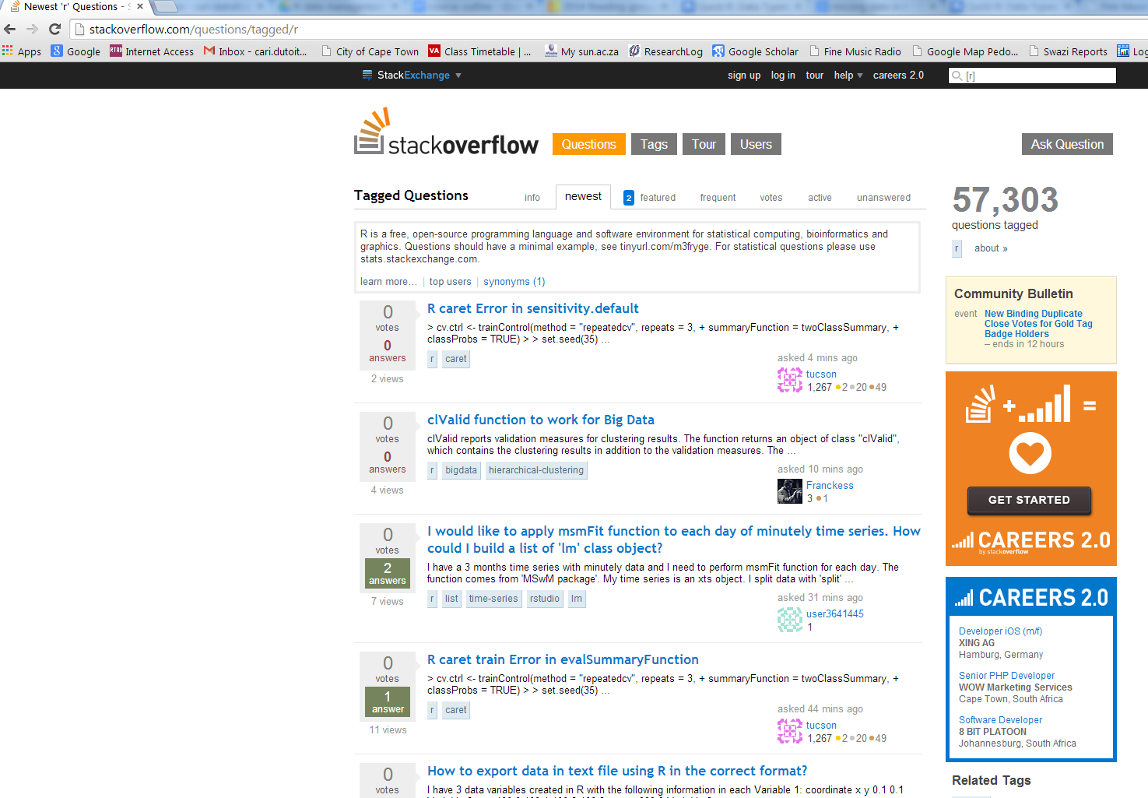
stackoverflow.com
You can search or ask a R related question in the forum www.stackoverflow.com

Slide 13
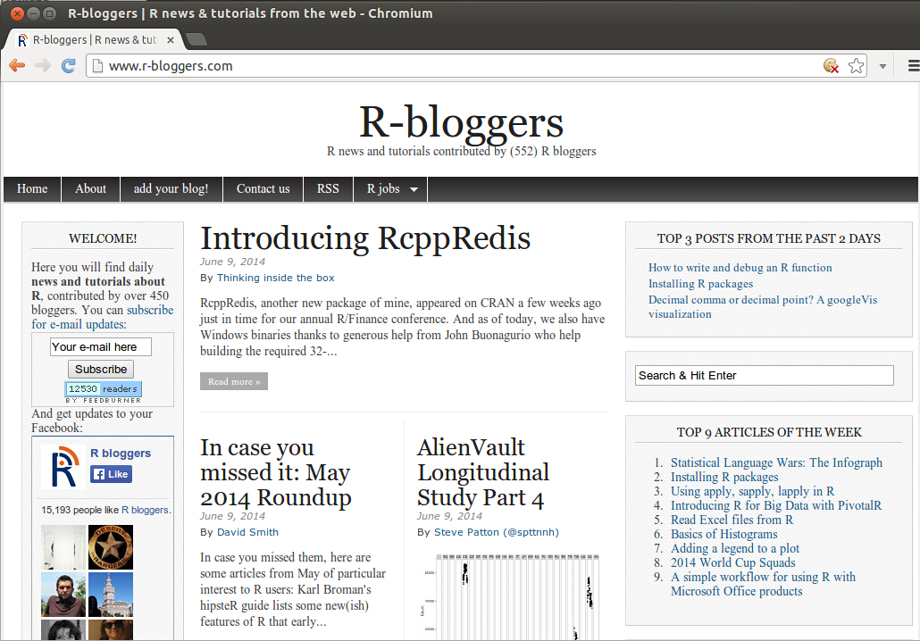
r-bloggers.com
R-Bloggers.com is a central hub (e.g: A blog aggregator) of content collected from bloggers who write about R (in English).

Slide 14
Vignettes
Some packages come with vignettes. They are essentially tutorials.
If we install the package “ape”,
library(ape)
Then enter:
vignette()
to see a list of all available vignettes on your computer.
To view one, enter:
vignette("MoranI", package="ape")

Slide 15
Tutorial
1) Install the following packages:
ggplot2 foreign Hmisc plyr colorspace
lubridate
ape knitr
MASS

Slide 16
2) Try find help for ggplot2.
2.1 If you cannot find help in R, where else can you look?
2.2 Find help for ggplot2.
2.3 Find the documentation for ggplot2.
3) When was the first version of foreign available on CRAN?
3.1 What is the Title in the help for foreign?
4) For “Hmisc “, what is the description from the help?
5) From the description in the help, what pattern does plyr make use of? And, what does this mean?
6) Besides RGB, give two other sets of colours from colorspace.
7) What does the package “lubridate” deal with?
8) From the help section, what does “ape” stand for?
9) From the help section, what is knitr an alternative to? And, how would you explain what it can be used for to someone else?
10)From the help section, give two datasets, and two functions from the package “MASS”.
Notes:
It is a bit ambiguous what you mean by “the documentation”. Do you mean the vignette? The help file? Documentation on the R website? On some other website?
I wouldn’t not have known where the find when the foreign package was first available on CRAN, not even after seeing the solution. I don’t think the solution should be the answer to the question only. It should be an explanation of how/where to find the answer.
Along the same line: the answer “ library(help="foreign”) ” is not one that I could have found. In the slides I don’t see reference to this way of searching for help.
Is there another way to get to the information about a package (e.g. colorspace) than by typing library(help="colorspace") ?

Slide 17
answers
1)
2) http://ggplot2.org/ and http://docs.ggplot2.org/current/
3) 17-Dec-1999
3.1) from: library(help="foreign")
“Read Data Stored by Minitab, S, SAS, SPSS, Stata, Systat, Weka, dBase, ...”
4) from: library(help="Hmisc")
“The Hmisc package contains many functions useful for data analysis, high-level graphics, utility operations, functions for computing sample size and power, importing datasets, imputing missing values, advanced table making, variable clustering, character string manipulation, conversion of R objects to LaTeX code, and recoding variables.”
5) the split-apply-combine pattern in R.
6) HLS, HSV, LAB, LUV.
7) Time. “Lubridate provides tools that make it easier to parse and manipulate dates.“
8) Analyses of Phylogenetics and Evolution.
9) alternative tool to Sweave. “The knitr package was designed to be a transparent engine for dynamic report generation with R”
10) library(help="MASS")

